Slide 1
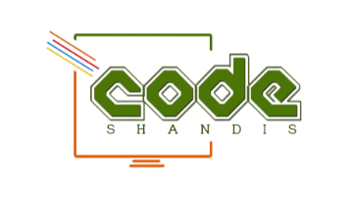
Modern Software Development and Infrastructure
Presenter : Tokologo Chabalala
Profession: DevOps Engineer

Slide 2
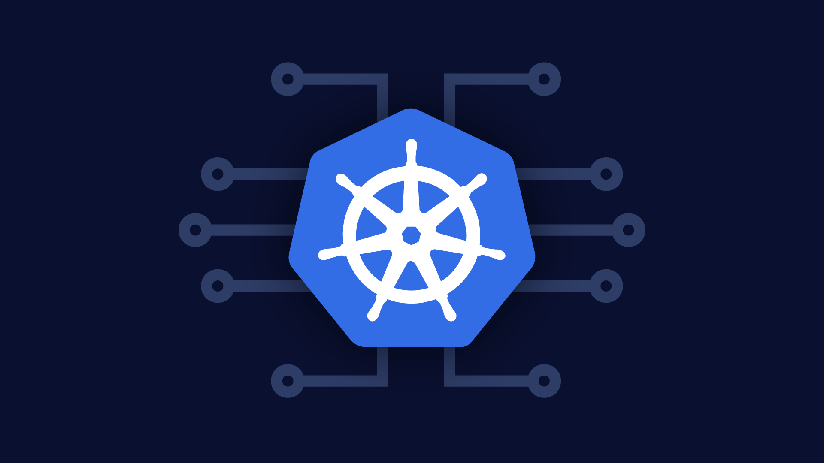
What a Stack
Docker
Kurbenetes
Docker
Kubernetes

Slide 3
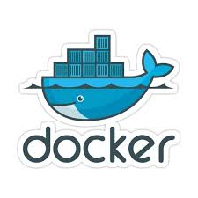
What is Docker
Docker allows to package an application into a
standardized unit for software development:
– The Docker Container
A Docker Container wraps a
piece of software in a complete
filesystem which contains all
needed resources
Docker written in ‘go language ‘
A Docker Container runs
on Linux, Windows, macOS,
and most Cloud infrastructures
First Release in March 2013 by Solomon hykes and Sebastain Pahl

Slide 4
Docker Promise : Build, Ship, Run !!
Docker enables reliable deployments
– Build here, run there

Slide 5
Advantage over classical virtualization
Setting up a Virtual Machine requires additional tools for provisioning such as Puppet, Chef, Ansible, Vagrant, shell scripts and more ...
– Tools such as Packer do support builder and provisioners
But ...
– Docker comes with template Docker images hosted at hub.docker.com
– Easy to extend with custom software, libraries, files defined in a single Dockerfile
– Images are version controlled and lightweight
– Supports the Dev&Ops paradigm Infrastructure-as-Code

Slide 6
How to use Docker
● Check if correct Docker version is installed:
docker version
● Run first Docker container:
docker run hello-world
● First, Docker Image is searched locally, when not found
● Then, Docker Image is pulled from DockerHub.
● Split up command:
docker pull hello-world
docker run hello-world

Slide 7
How to use Docker
● States of a Docker application:
– Dockerfile
● Configuration to create a Docker Image.
– Docker Image
● Image can be loaded by Docker and is used to create Docker Container.
– Docker Container
● Instance of a Docker Image.
● Dockerfile
– Build a Docker Image from Dockerfile with:
docker build -t imagename .
Docker File is located here!!!

Slide 8

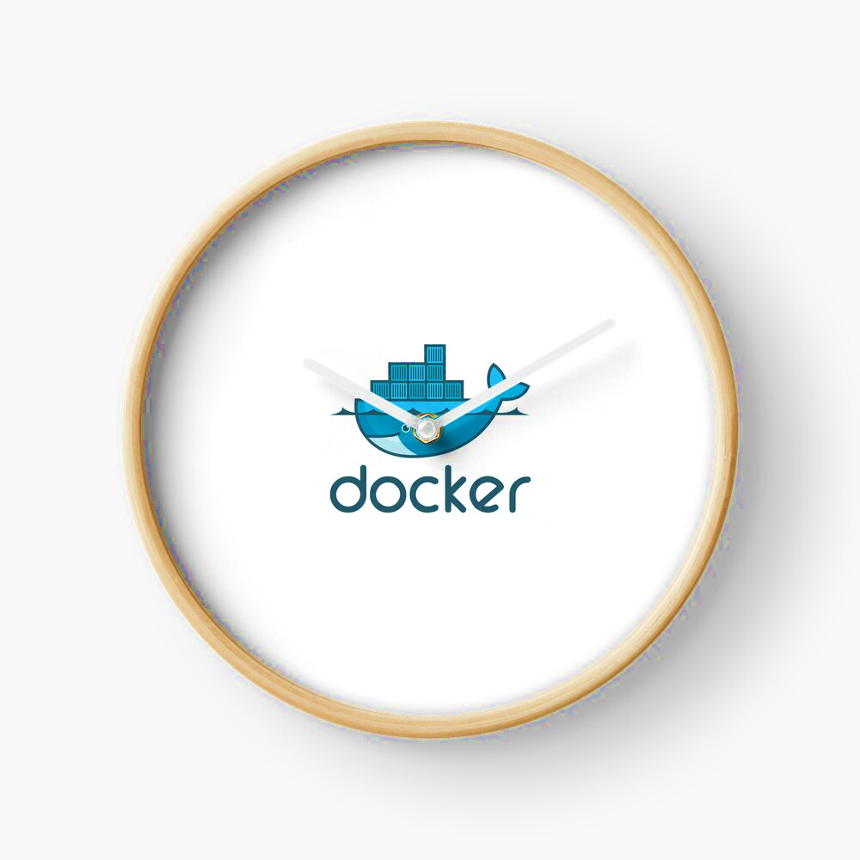
Demo Time !!

Slide 9
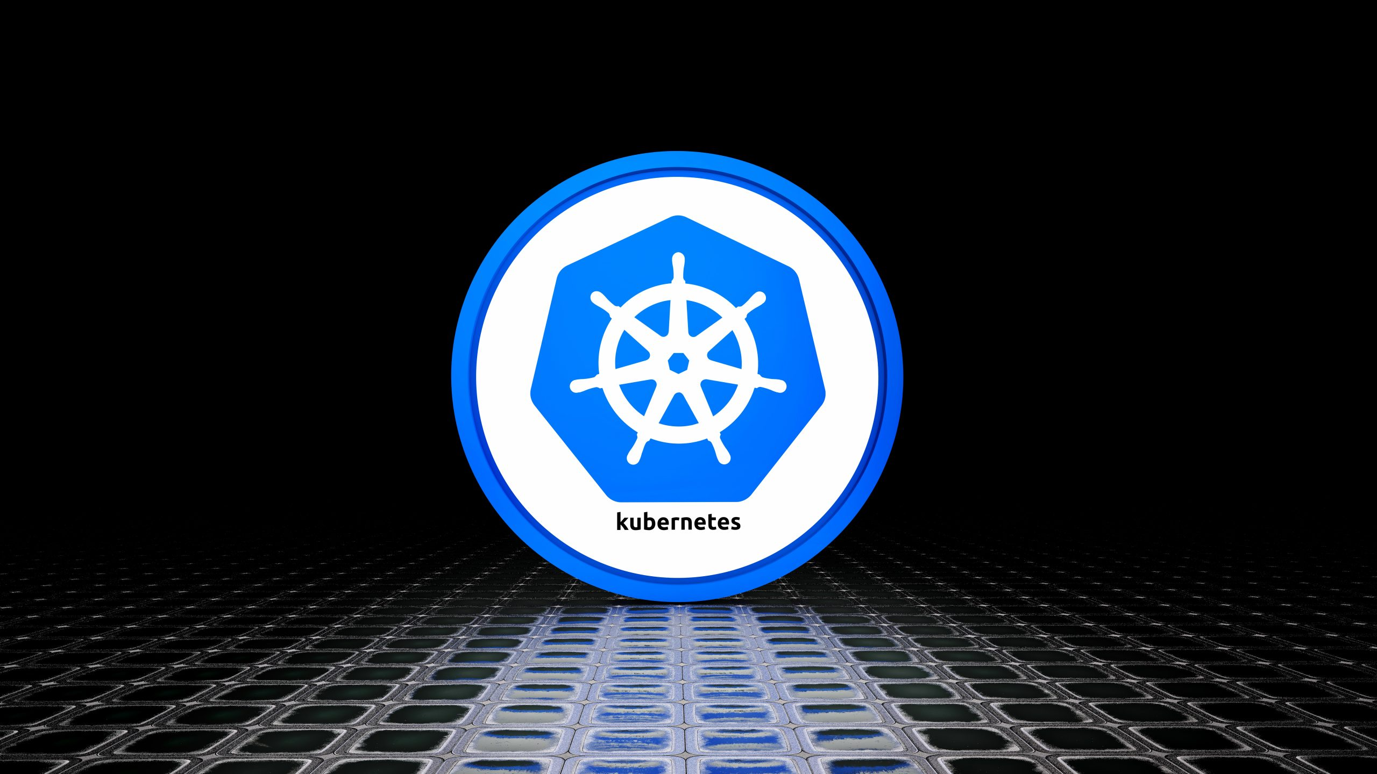

Kubernetes

Slide 10
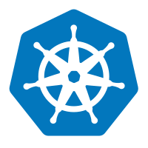
What is Kubernetes
Kubernetes is an open-source container orchestration platform that automates the deployment, scaling, and management of containerized applications. It is important because it simplifies the management of containerized workloads, ensures high availability, and enables efficient resource utilization.

Slide 11
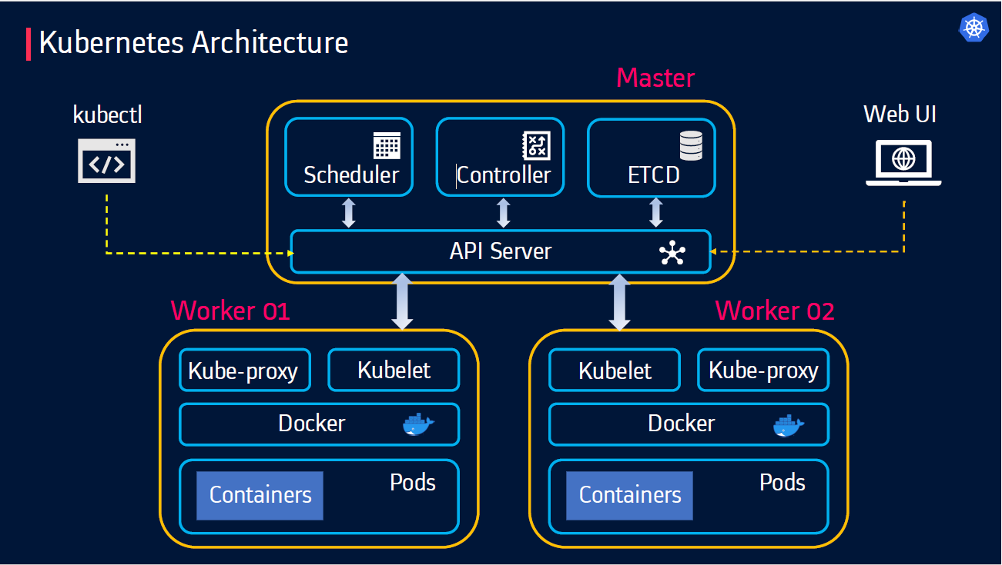
Kubernetes cluster key components
Notes:
Master Node: Manages the overall cluster and its state.
Node (Minion): Hosts containers and is controlled by the master node.
Kubelet: Agent that runs on each node and communicates with the master.
Kube Proxy: Maintains network rules on nodes.
etcd: Consistent and highly available key-value store for cluster data.

Slide 12
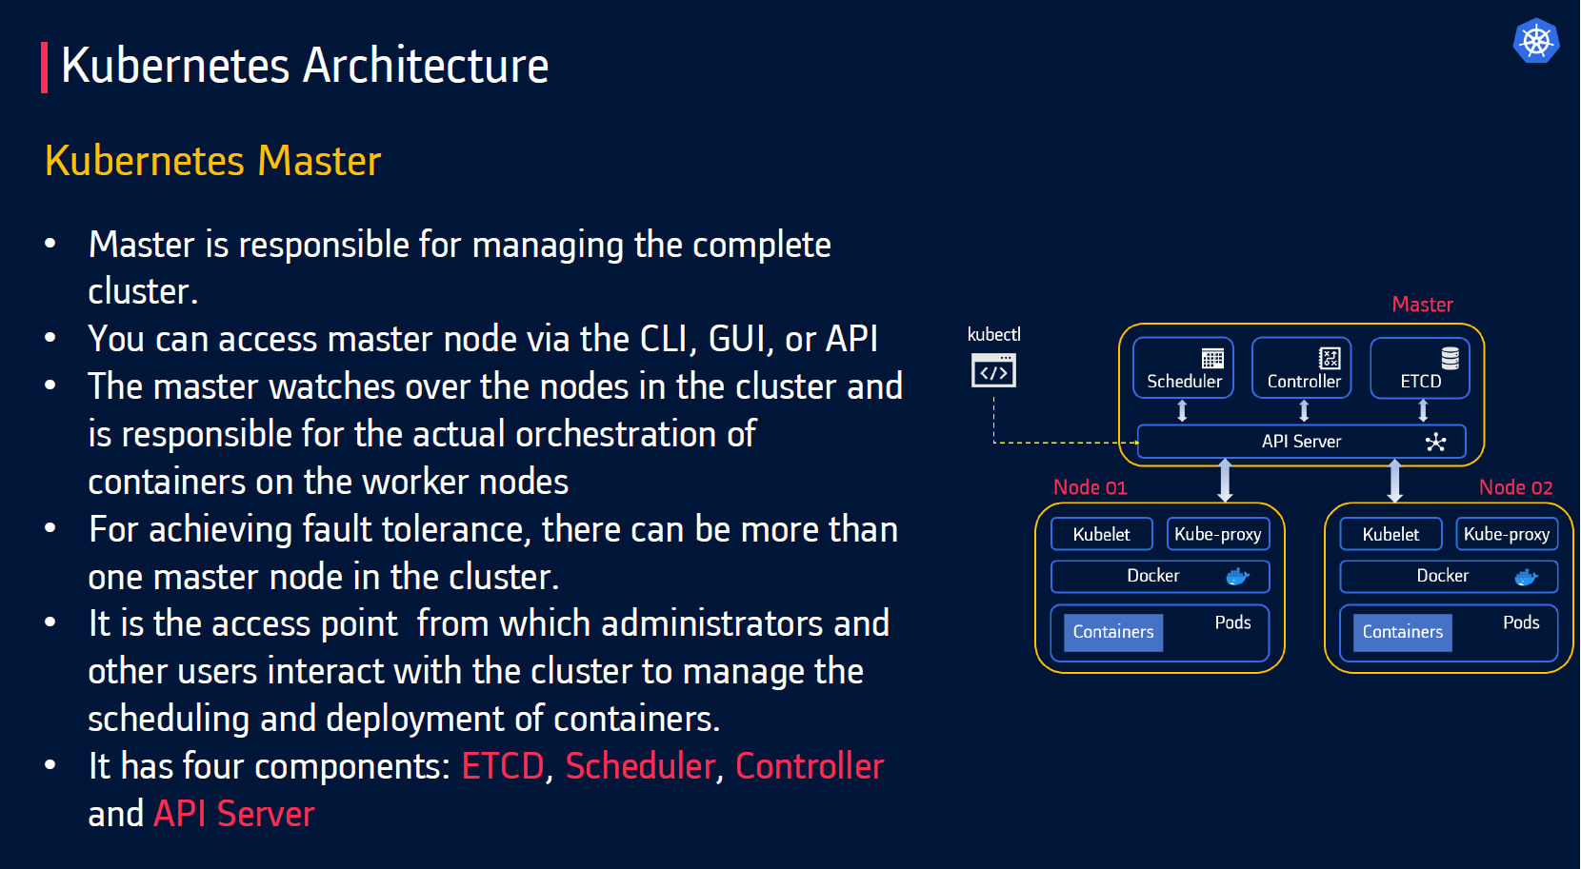
Master Node
Notes:
ETCD -
ETCD is a distributed reliable key-value store used byKubernetes to store all data used to manage the cluster.
•When you have multiple nodes and multiple masters in your cluster, etcd stores all that information on all the nodes in the cluster in a distributed manner.
•ETCD is responsible for implementing locks within the cluster to ensure there are no conflicts between the Masters
Scheduler
Schedular
The scheduler is responsible for distributing work or containers across multiple nodes.
•It looks for newly created containers and assigns them to Nodes.
API Server Manager
•Masters communicate with the rest of the cluster through the kube-apiserver, the main access point to the control plane.
•It validates and executes user’s REST commands
•kube-apiserveralso makes sure that configurations in etcd match with configurations of containers deployed in the cluster.
Controller manager
•The controllers are the brain behind orchestration.
•They are responsible for noticing and responding when nodes, containers or endpoints goes down. The controllers makes decisions to bring up new containers in such cases.
•The kube-controller-manager runs control loops that manage the state of the cluster by checking if the required deployments, replicas, and nodes are running in the cluster
Kubectl
•kubectl is the command line utility using which we can interact with k8s cluster
•Uses APIs provided by API server to interact.
•Also known as the kube command line tool or kubectl or kube control.
•Used to deploy and manage applications on a Kubernetes
Kubelet
•Worker nodes have the kubelet agent that is responsible for interacting with the master to provide health information of the worker node
•To carry out actions requested by the master on the worker nodes.
Kube proxy
•The kube-proxy is responsible for ensuring network traffic is routed properly to internal and external services as required and is based on the rules defined by network policies in kube-controller-manager and other custom controllers.

Slide 13
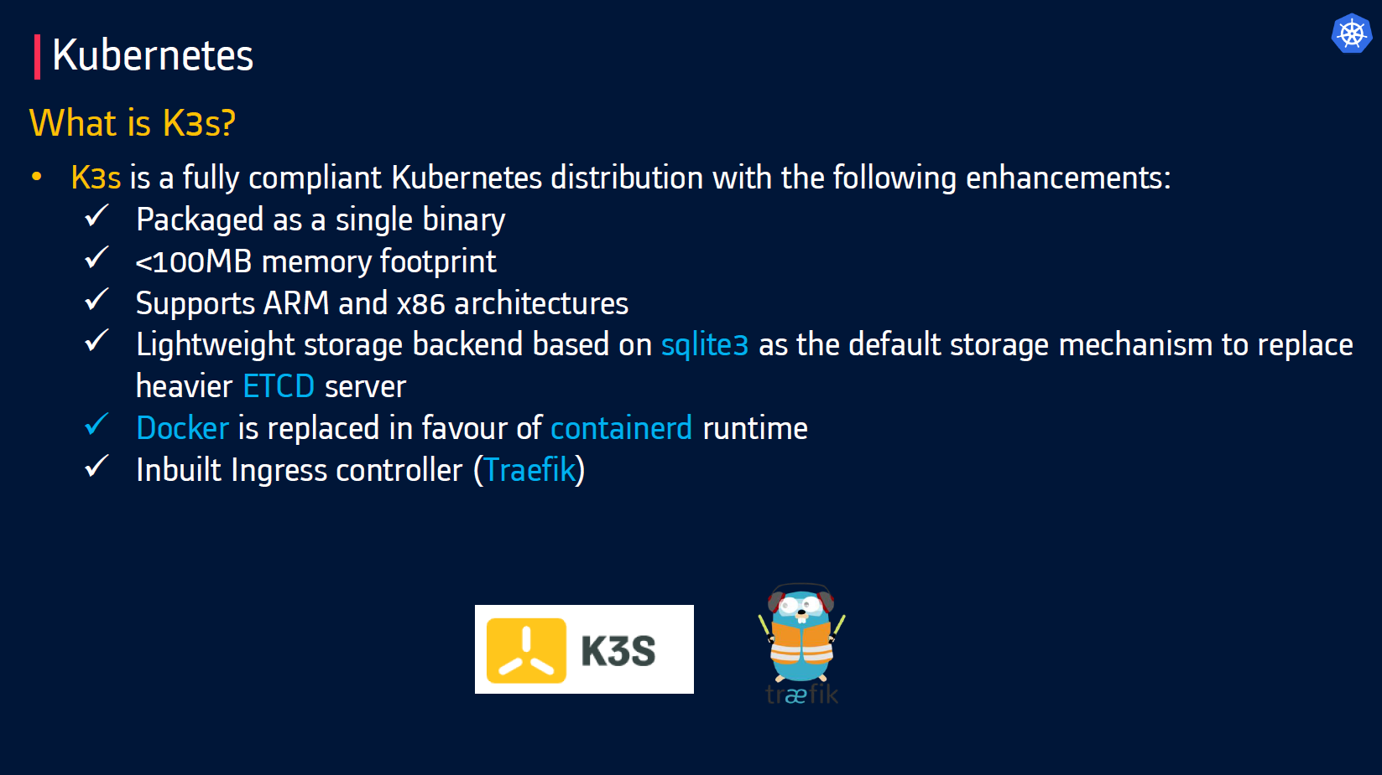
Extra Extra Pods are all about it

Slide 14
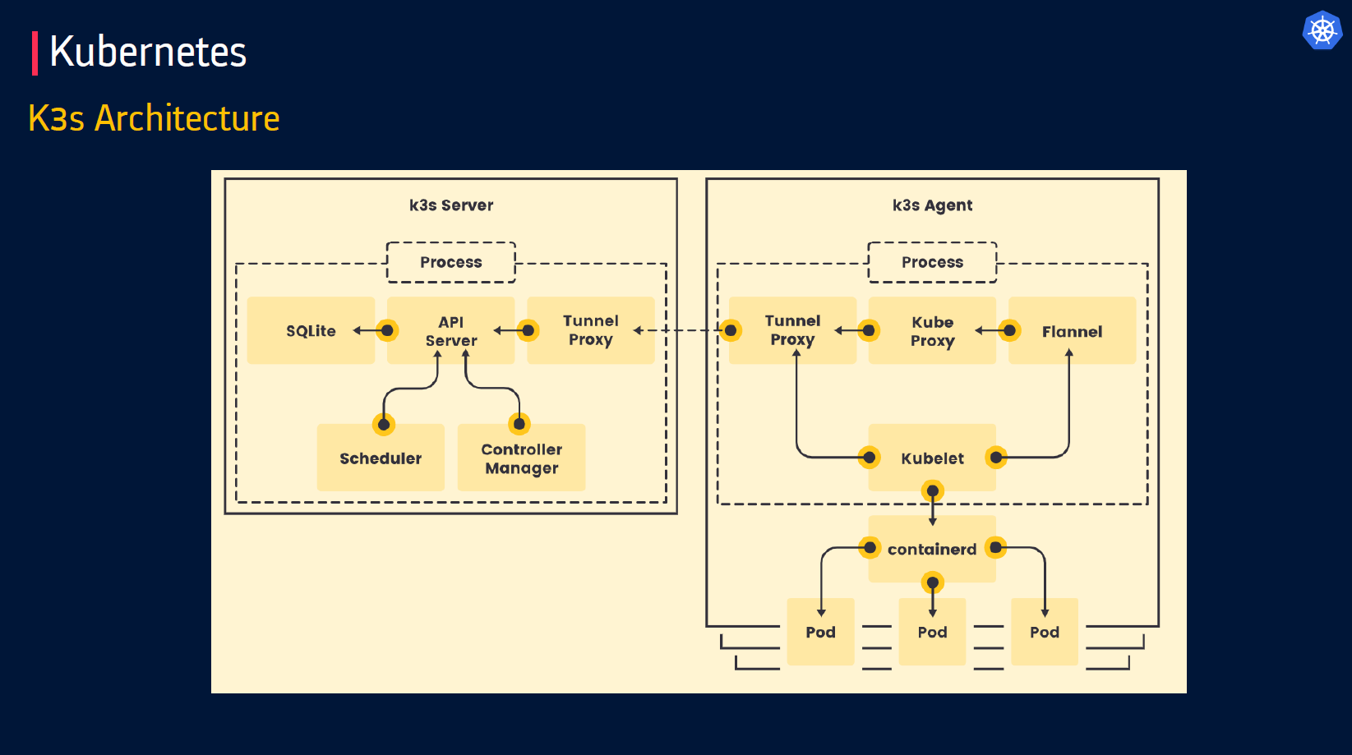
Extra Extra Pods are all about it

Slide 15
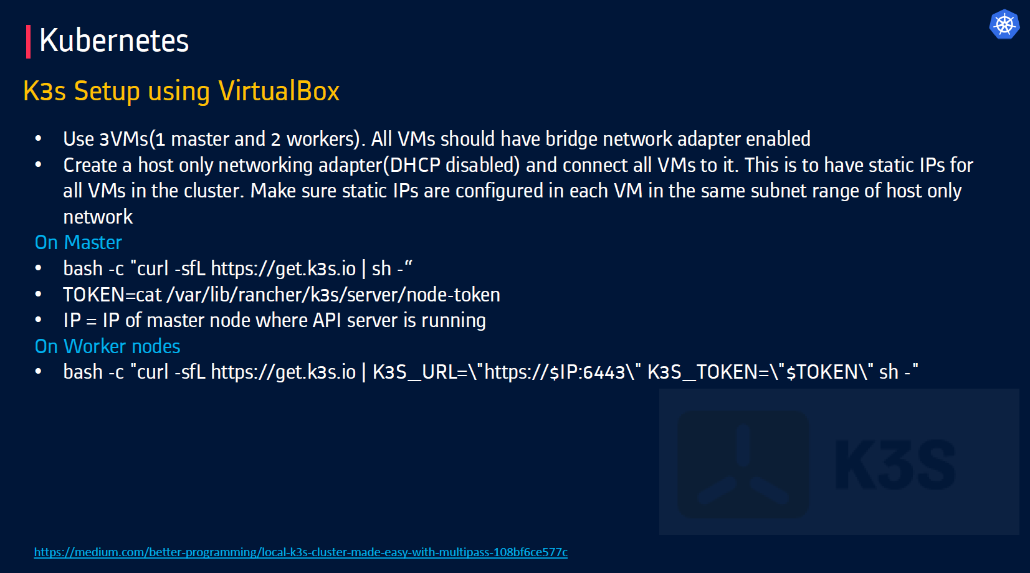
Extra Extra Pods are all about it

Slide 16
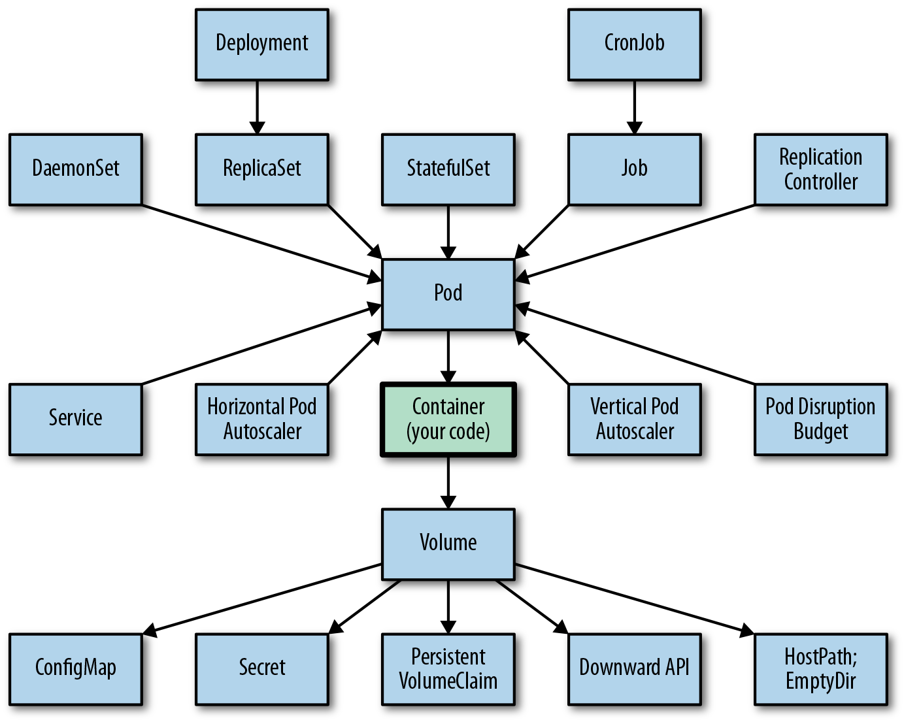
Kubernetes Object
Notes:
Pod : A thin wrapper around one or more containers
Pods are often ephemeral" means that in a system like Kubernetes, Pods are designed to be temporary and short-lived, meaning they are created, used for a specific task, and then automatically deleted without any expectation of long-term data persistence; essentially, they are disposable units that can be quickly spun up and down as needed
Service: Maps a fixed IP address to a logical group of pods
Volume: a directory with data that is accessible across multiple containers in a Pod
Namespace: a way to organize clusters into virtual sub-clusters
ReplicaSets: Ensures a defined number of pods are always running
Replica Controller : Ensures a defined number of pods are always running
Secrets: an object that contains a small amount of sensitive data such as a password, a tok1en, or a key
Config Maps: an API object that lets you store configuration for other objects to use
Deployments : Details how to roll out (or roll back) across versions of your application
StatefulSets: the workload API object used to manage stateful applications
Jobs: Ensures a pod properly runs to completion and stop after process complete it's execution
Daemon Sets: Implements a single instance of a pod on all (or filtered subset of) worker node(s)
Label: Key/Value pairs used for association and filtering

Slide 17
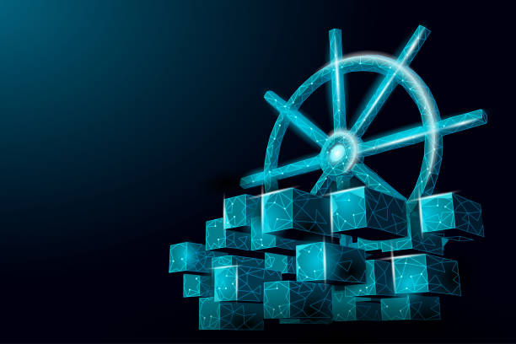
Demo Time !!

Slide 18
THE END
Notes:
Pods are often ephemeral" means that in a system like Kubernetes, Pods are designed to be temporary and short-lived, meaning they are created, used for a specific task, and then automatically deleted without any expectation of long-term data persistence; essentially, they are disposable units that can be quickly spun up and down as needed

